Slide 1
Assignment 9 Frequency Domain
Nusair Islam

Slide 2
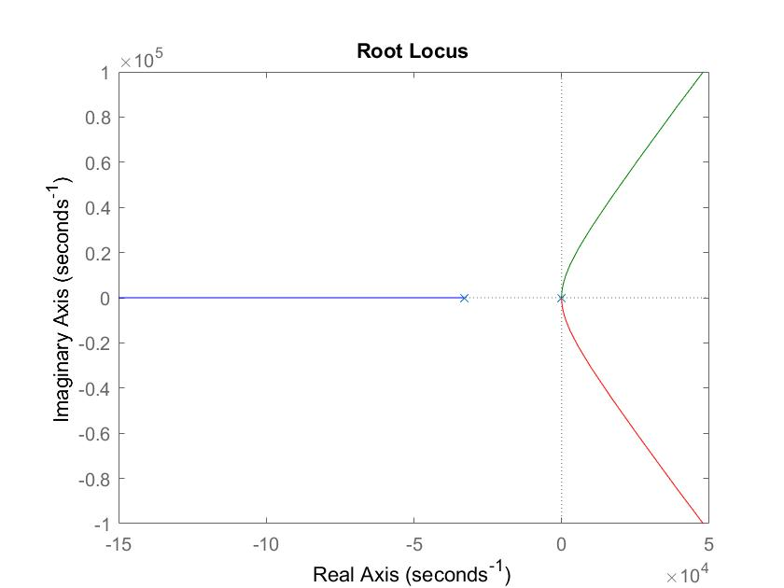
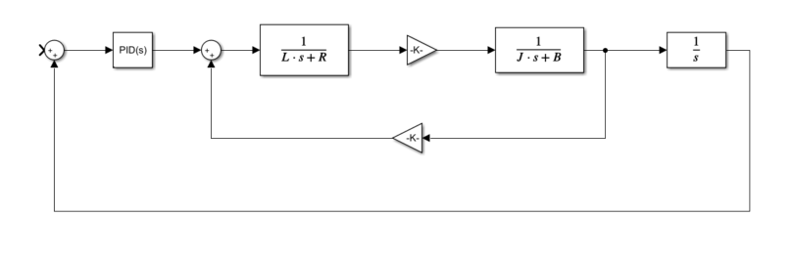
Step 2: P-controlled system and root locus

Slide 3
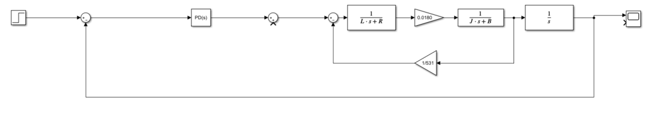
Step 3: I used the filter I created for assignment 8

Slide 4
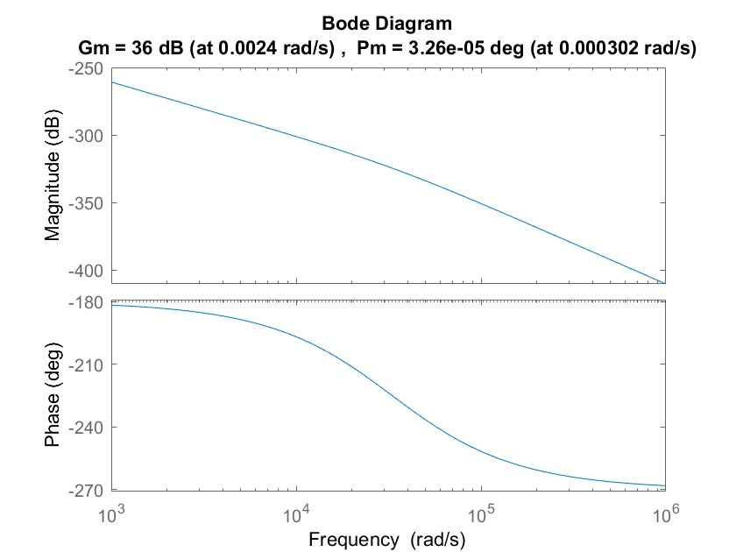
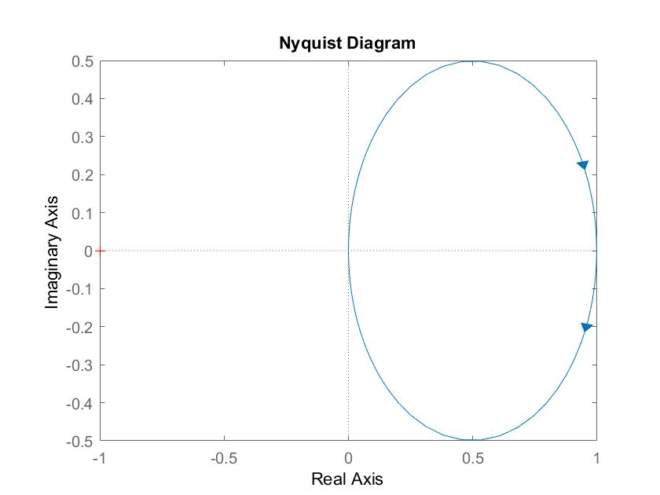
Step 4: Generated bode and Nyquist Plots of the last block diagram
Wx is located at 3.26e-05 degrees

Slide 5
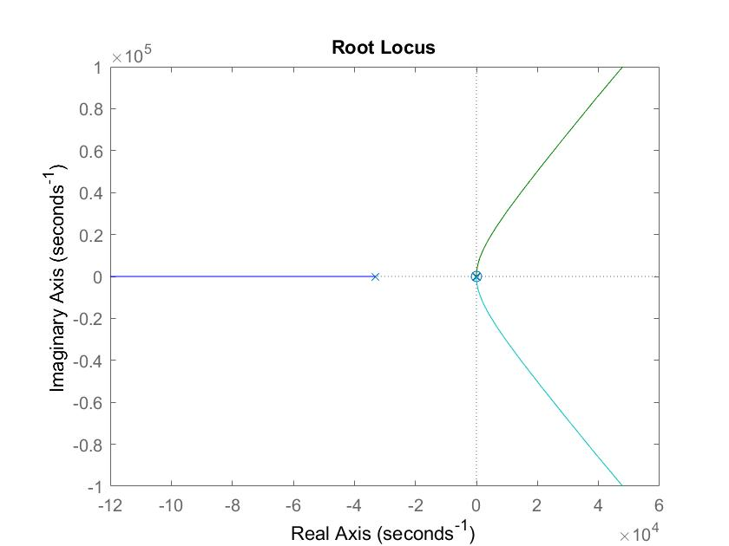
Step 5: The zero gets placed at wx and results in the following rlocus

Slide 6
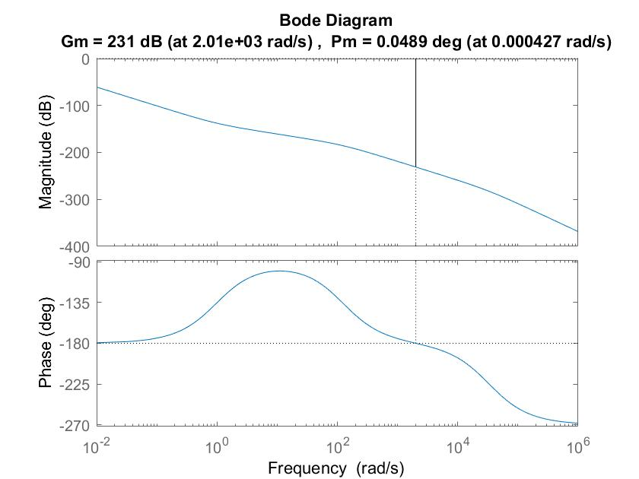
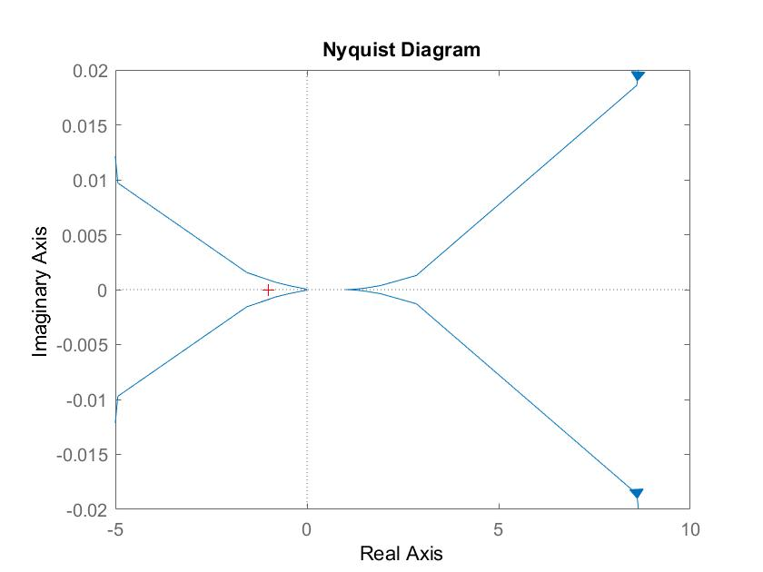
Step 6: Bode and Nyquist plots of unity gain
Ku = 3.59e+11

Slide 7
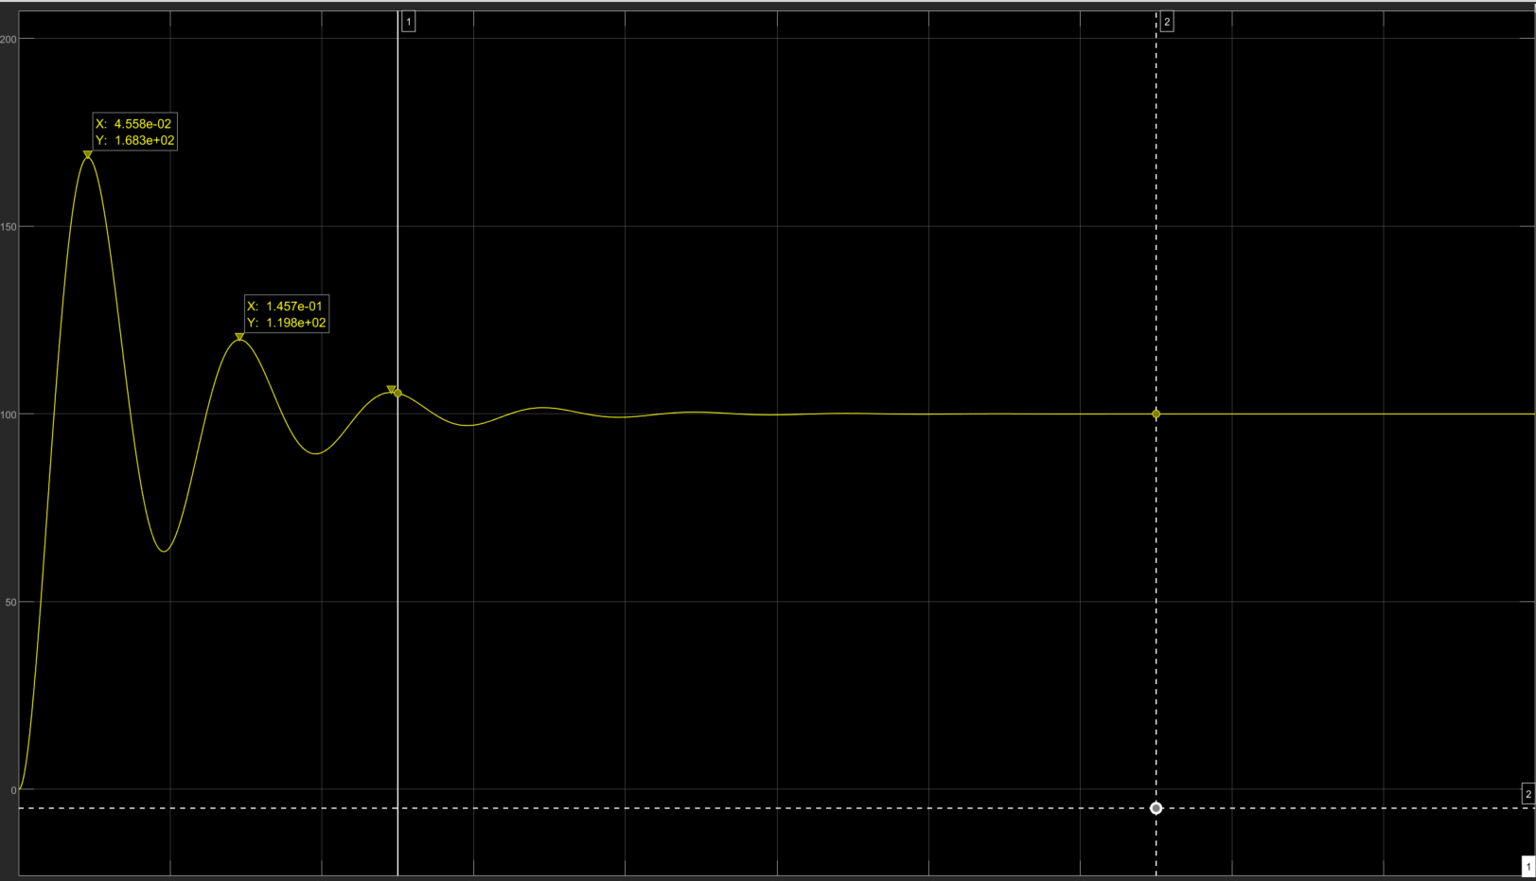
Step 7: New K and step response
K = 20%*3.59e+11 = 7.18e+10

Slide 8
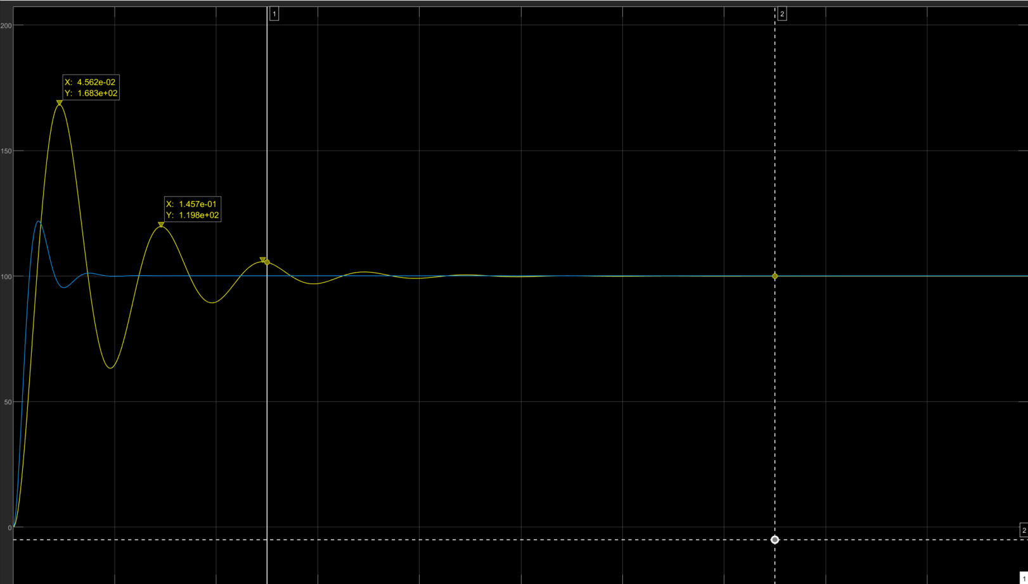
Step 7: New K and step response
As you can see changing
My k and z values resulted
In a much more stable-
Looking graph (blue)
Compared to the original
Yellow. The OS amount
Is smaller, and the Tr
Occurs sooner
I set my K = 2.154e+04
Z = 1.9219
P gain = 3.365e+09
D gain = 9.844e-01

Slide 9
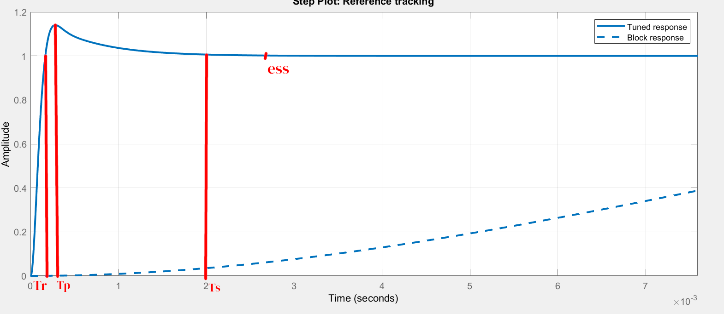
Step 8: Tuned PID step response
Tr = 169 us
Tp = 256 us
Ts = 2ms
Ess = 0

Slide 10
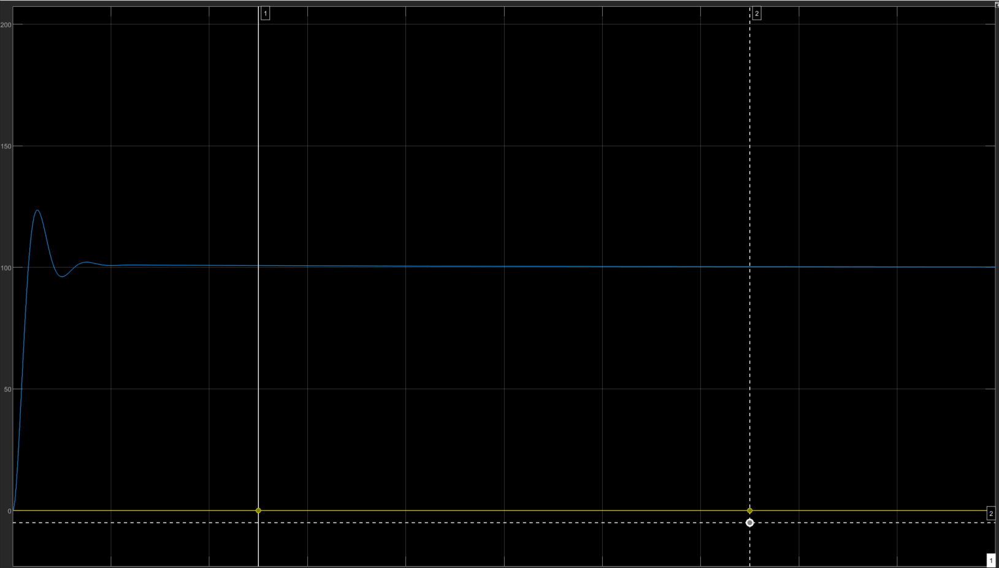
Step 9: PID controlled circuit and output

